Slide 1

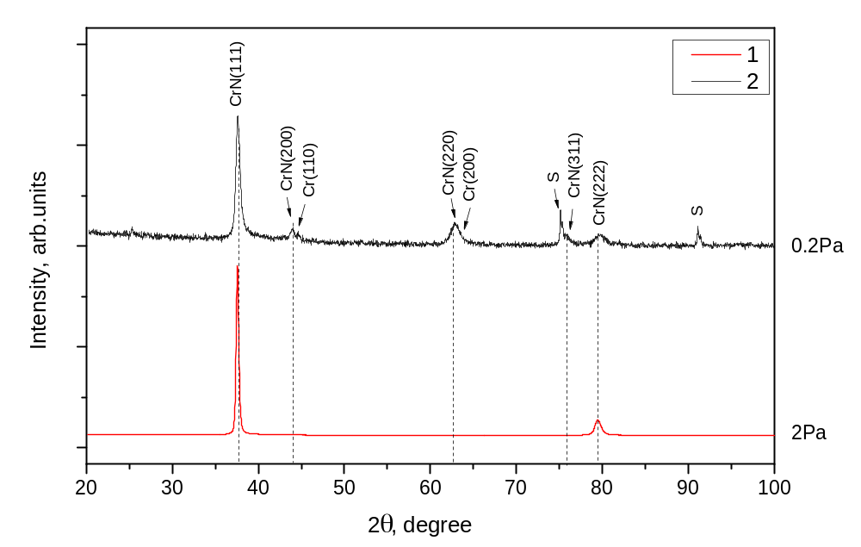
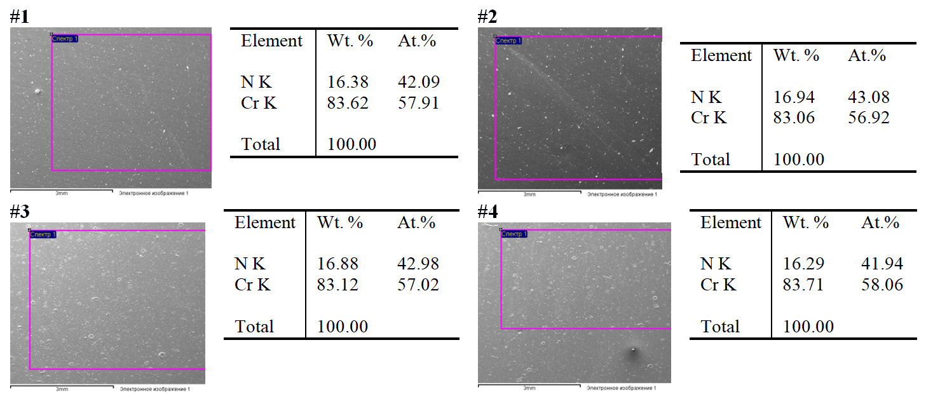
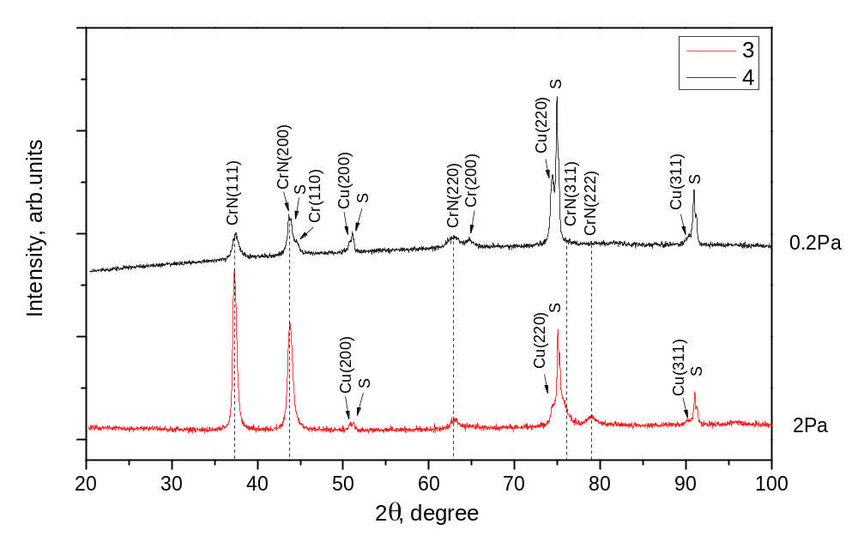
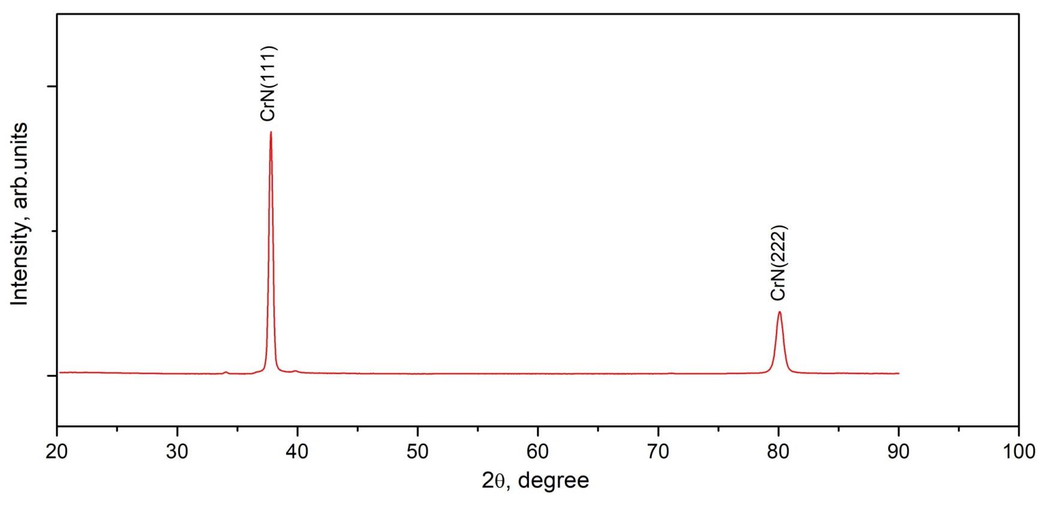
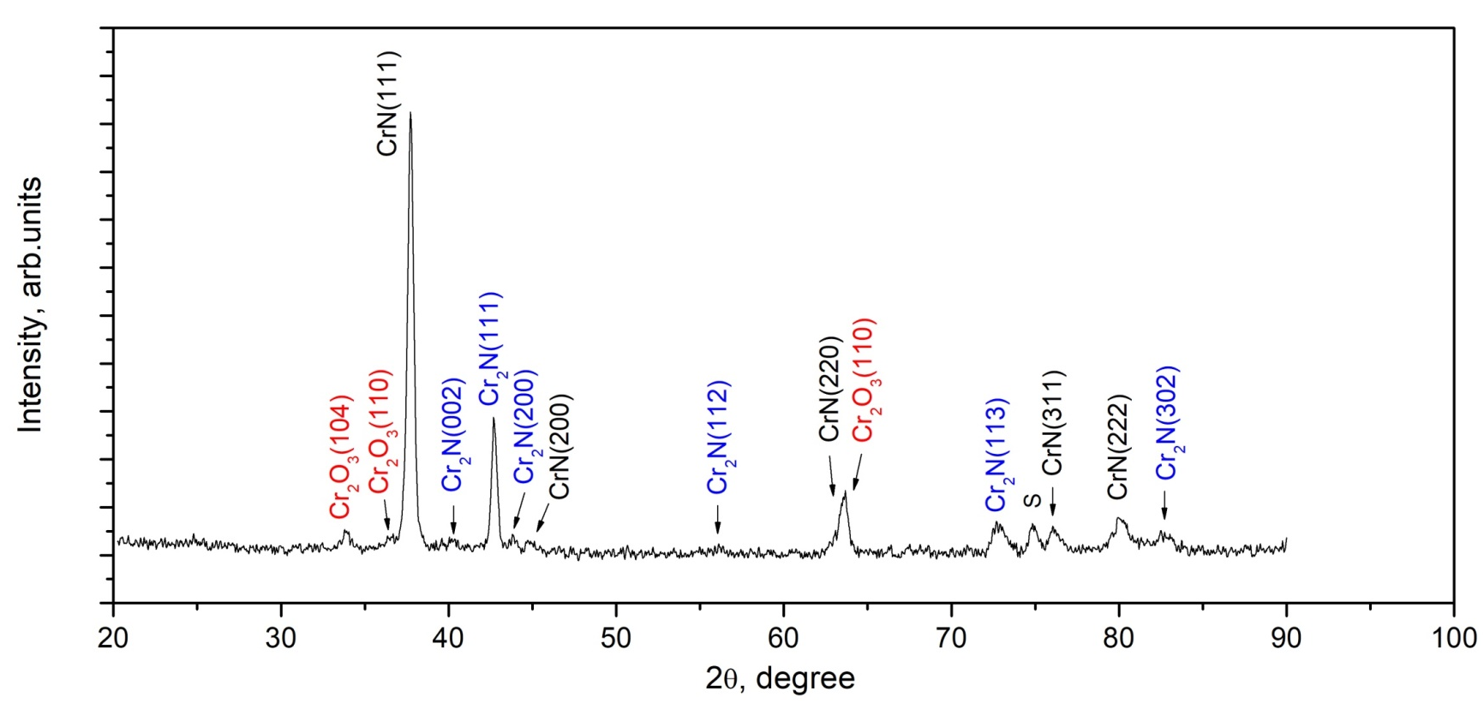
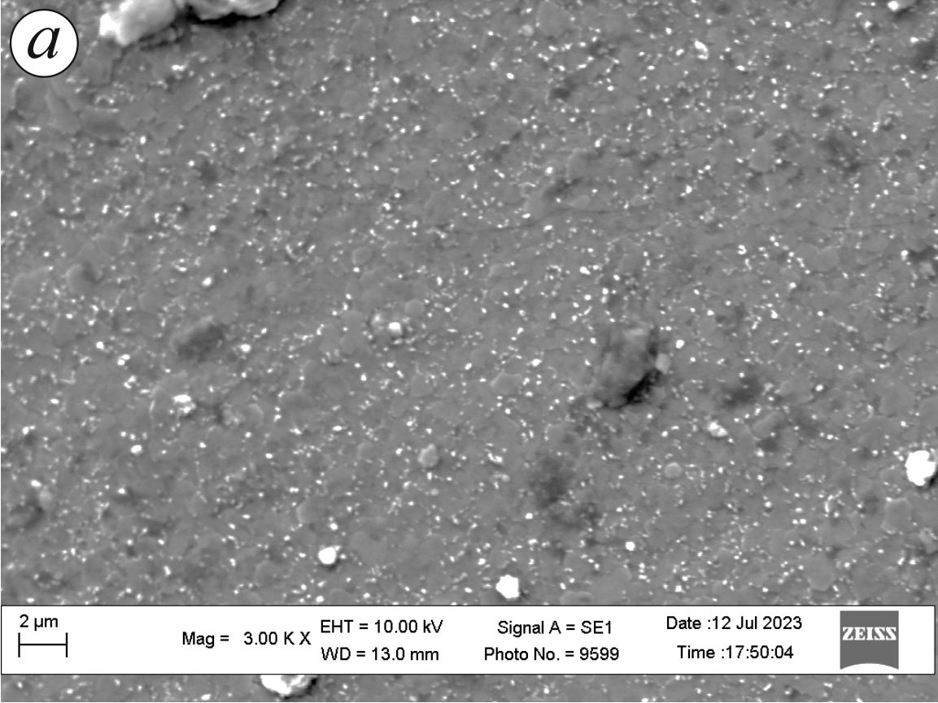
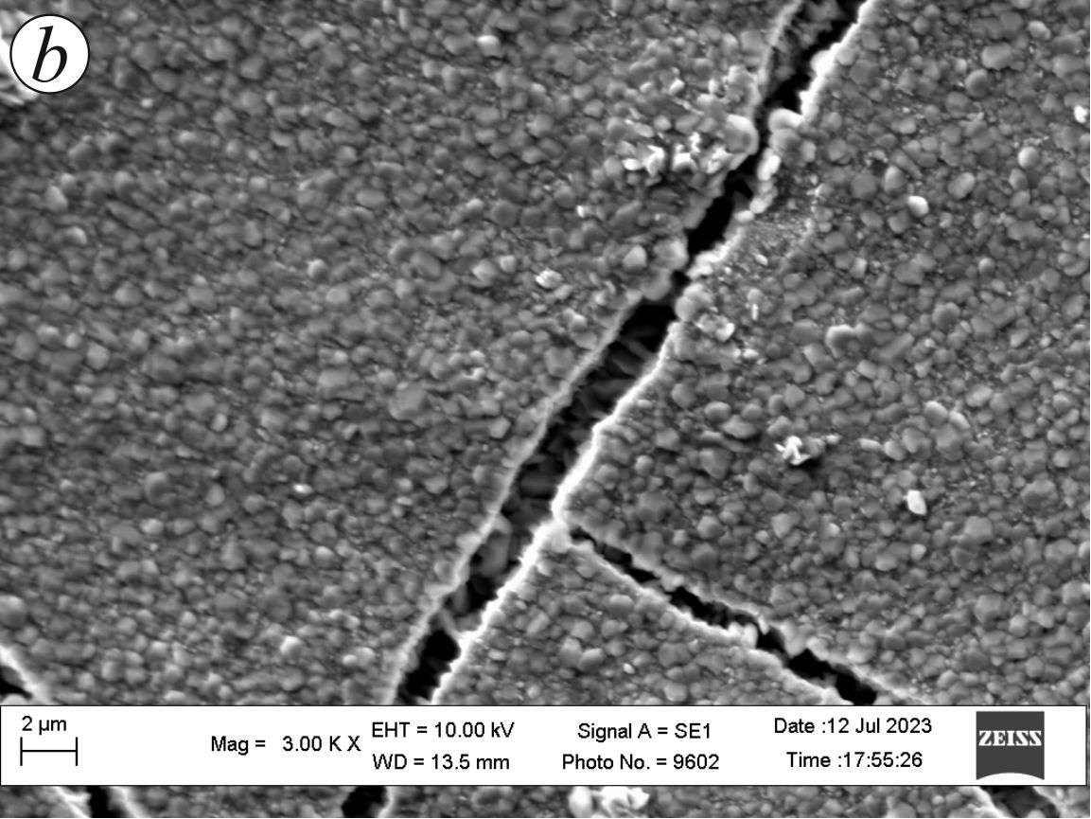
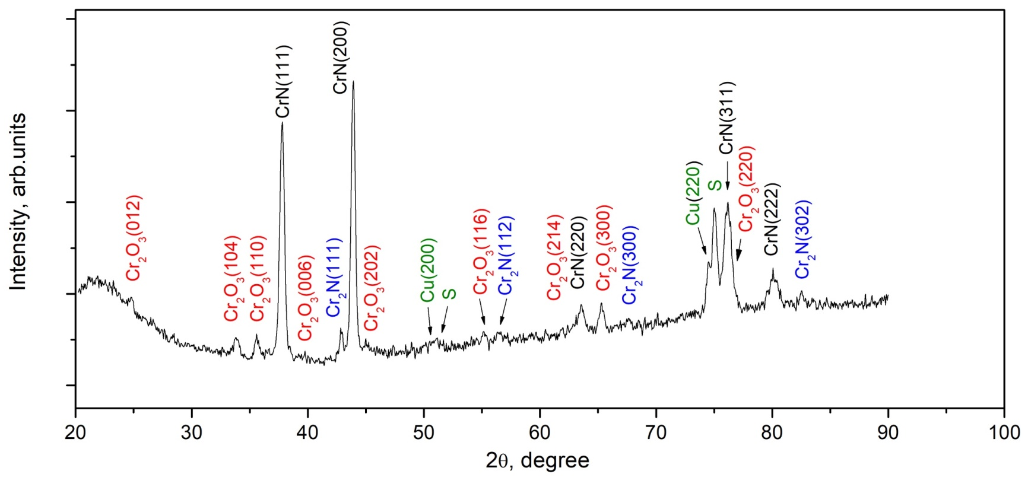
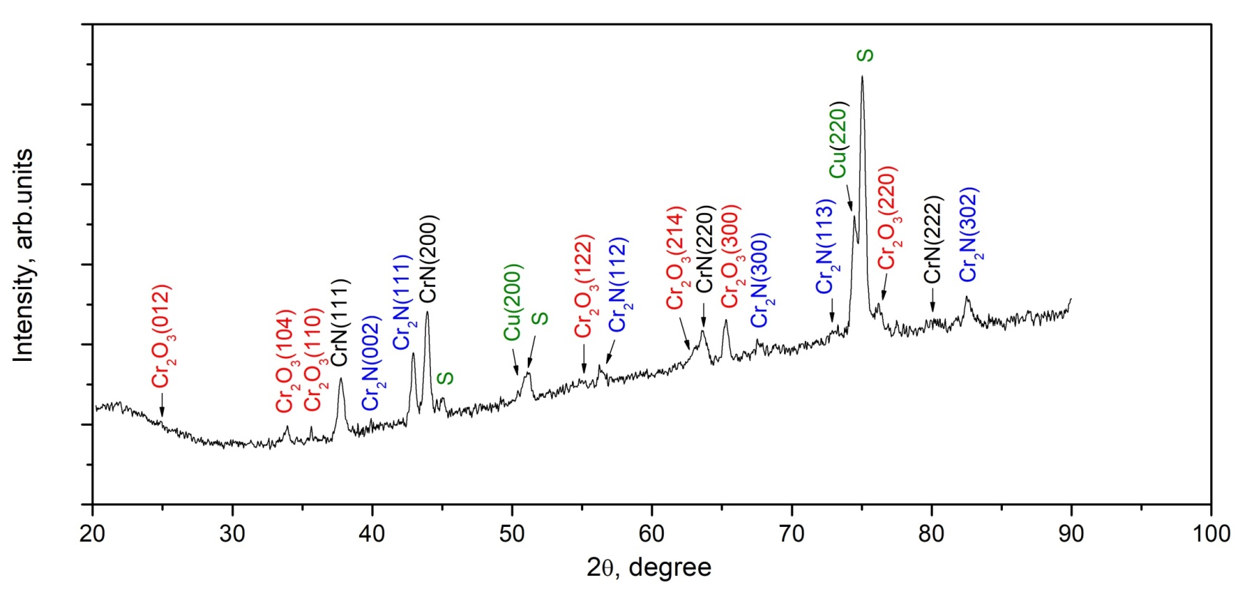
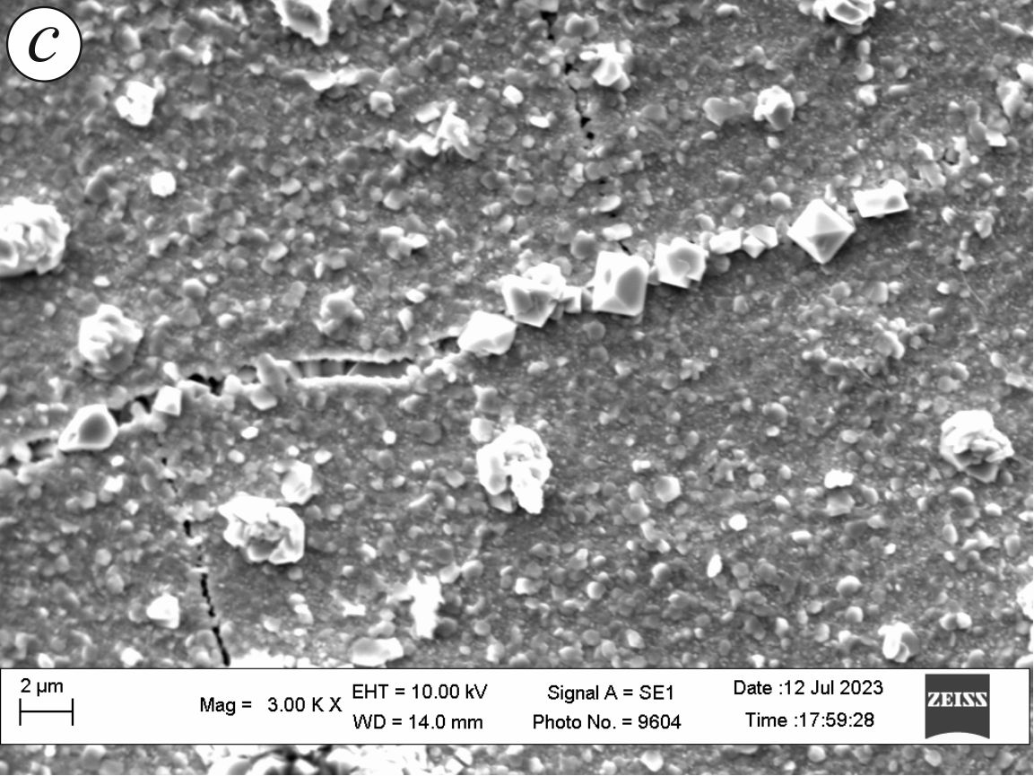
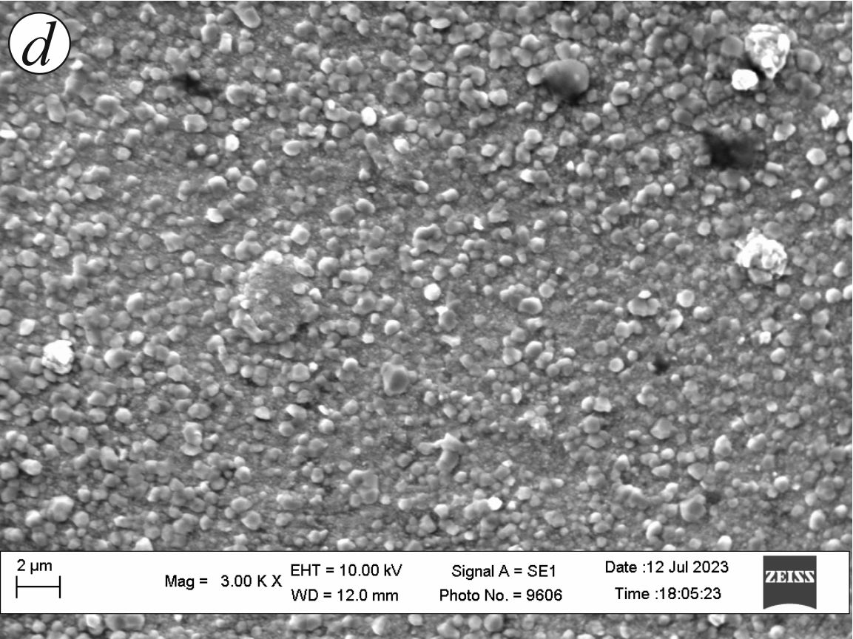


Development of a protective coating against high-temperature oxidation for fuel cell current collectors
24th International Conference “New Cryogenic and Isotope Technologies for Energy and Environment“ - EnergEn 2023
Băile Govora, Romania, October 18–20, 2023
Viktoriya Podhurska¹, Jaroslav Milewski², Olexander Kuprin³, Olena Reshetnyak³
¹ Karpenko Physico-Mechanical Institute of NASU, Lviv, Ukraine
² Warsaw University of Technology, Warsaw, Poland
³ National Science Center “Kharkiv Institute of Physics and Technology” of NASU, Kharkiv, Ukraine
Introduction
Bipolar plates and current collectors are metallic components for commercial MCFC stacks. For commercial MCFC systems, up to 55 % of the material content could be the metallic hardware (for the complete system). The stability in a corrosive carbonate atmosphere at high temperature, good electrical conductivity and low contact resistance with the electrodes are desired characteristics of bipolar plates and current collectors. Stainless steels like 310 S (24–26 wt. % Cr) and 304 L (16–18 wt. % Cr) have emerged as materials of choice for MCFC hardware. However, the hot corrosion in the presence of the carbonate melt is a critical issue with these materials for long-term operation. One of the methods of protecting and improving the corrosion properties of steel is the application of coatings based on nitrides. The corrosion resistance of Cr-N coatings is better than that of stainless steel and other nitride coatings in the high temperature pressurized water and the oxidation rate in air at 600/800°С is low. One of the most commonly deposition technique used is cathodic arc evaporation due to excellent characteristics of the coatings. The coatings are characterized by high hardness, good adhesion to the substrate, high density, homogeneity.
Results of X-ray structural analysis of coatings of the Cr-N system
№ specimen | Nitrogen pressure P, Pа | Bias voltage U, V | Thickness CrN, mm | Phases | Structural type | Lattice parameter а, nм | L, nм
1 | 2 | 150 | 16,6 | CrN | NaCl (B1) | 0,4173 | 38
2 | 0,2 | 120 | 6,9 | CrN | NaCl (B1) | 0,4166 | 19
 |  |  |  | Cr | BCC (A2)
3 | 2 | 150 | 4,1 | CrN | NaCl (B1) | 0,4180 | 21
 |  |  |  | Cu - sublayer | HCC (А1)
4 | 0,2 | 120 | 2,2 | CrN | NaCl (B1) | 0,4177 | 12
 |  |  |  | Cr | BCC (A2)
 |  |  |  | Cu - sublayer | HCC (A1)
Results of X-ray structural analysis of coatings of the Cr-N system after long-oxidation (1000h) at 600°C in the air
1
2
1
2
3
4
3
4
ACKNOWLEDGEMENT
This study was supported by „Scheme: Support for Ukrainian researchers under Bilateral Fund of ‘Applied Research’ Programmer” under the Norwegian Financial Mechanism 2014-2021 [akronim: MOLCAR_UA].

