Slide 1


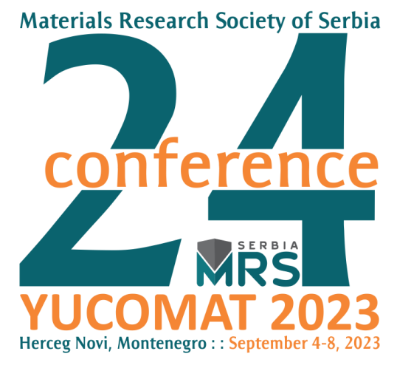
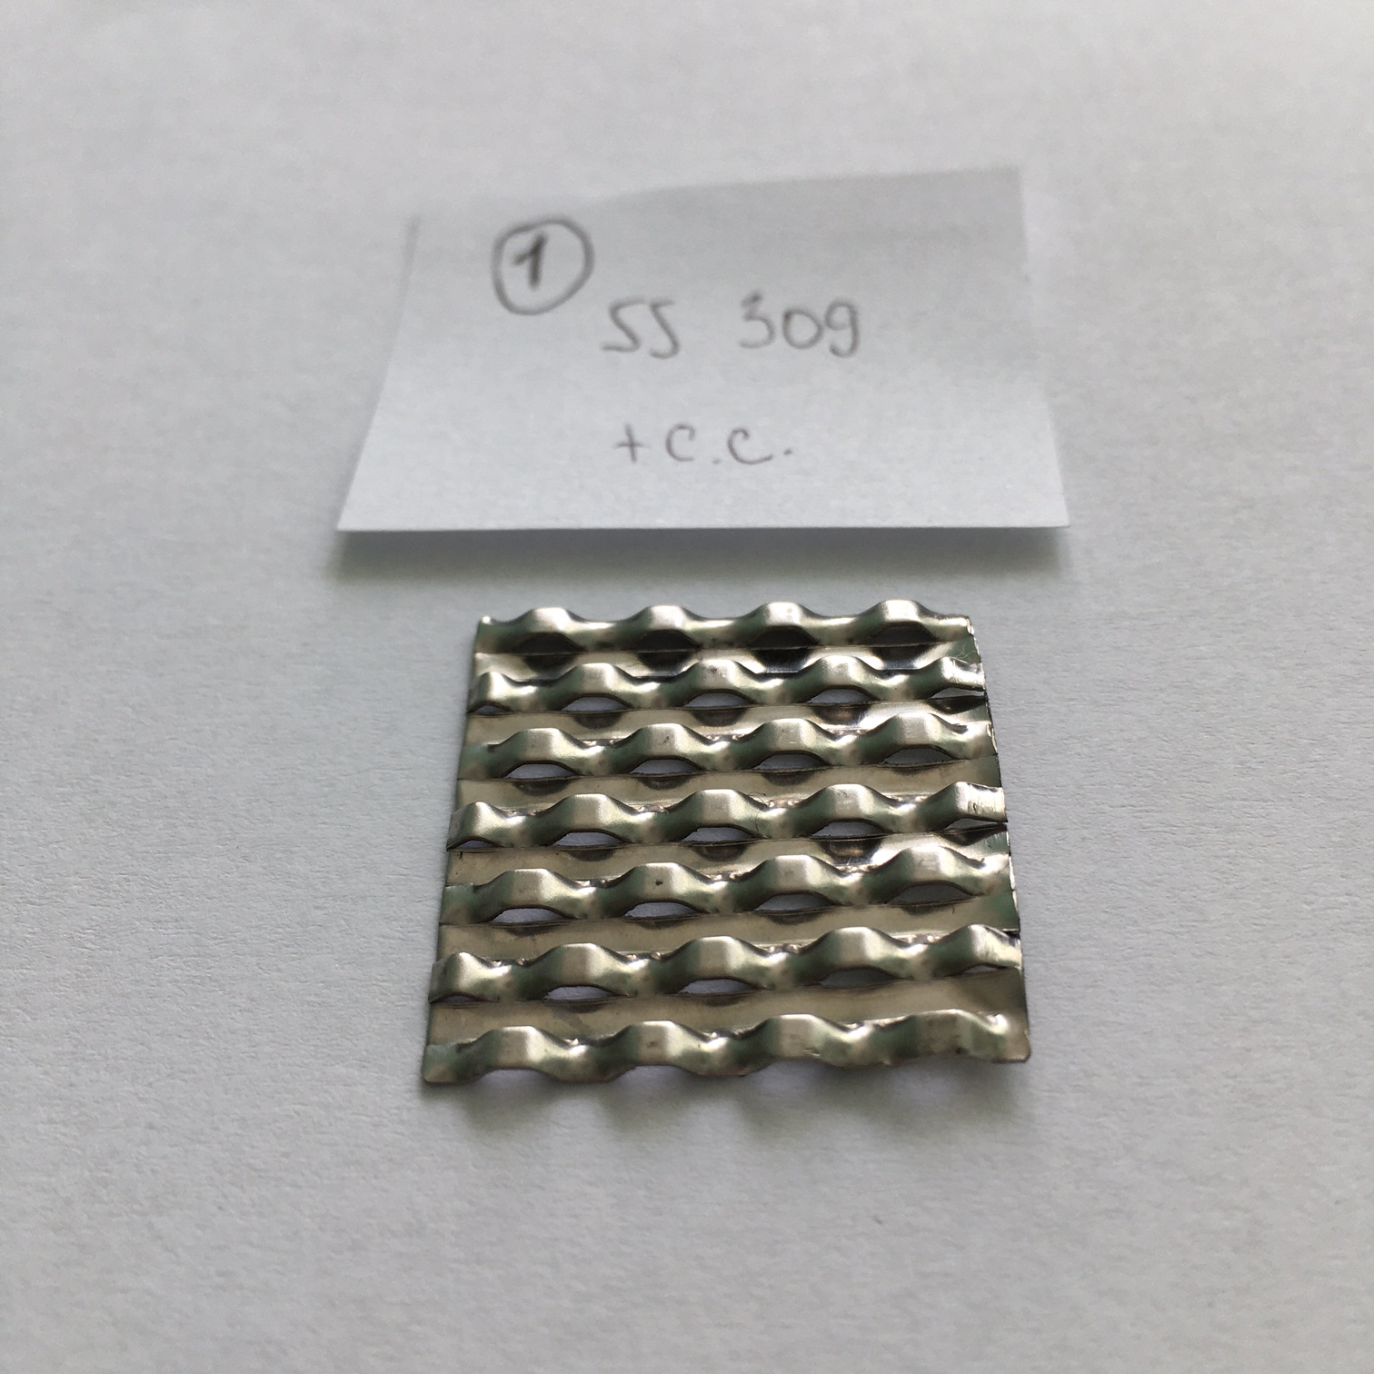
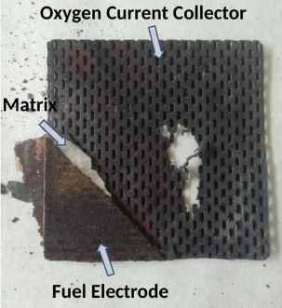
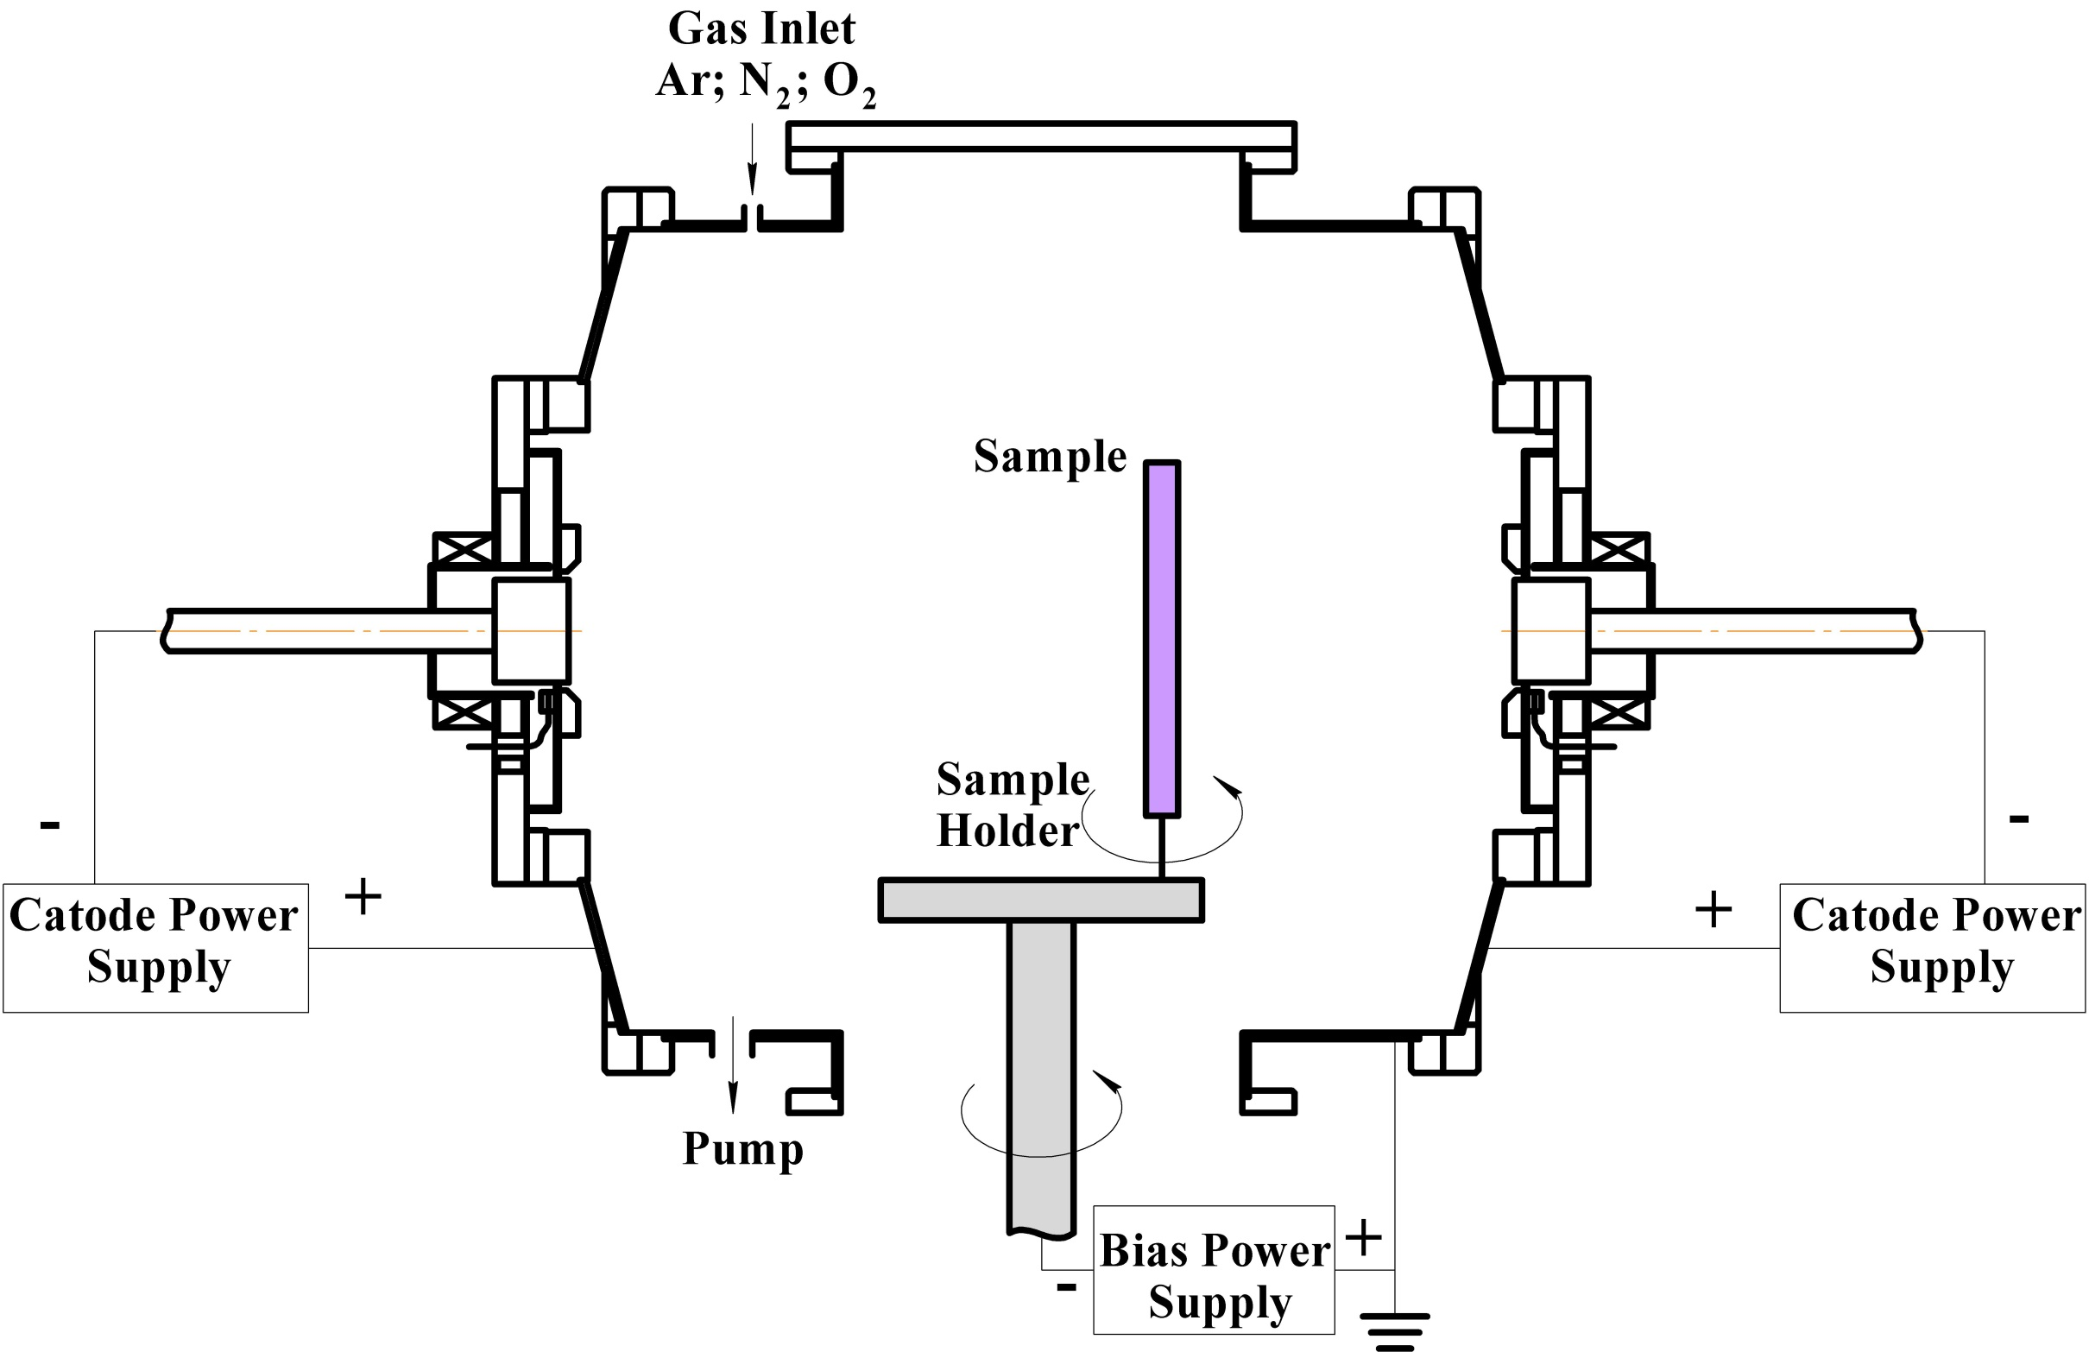
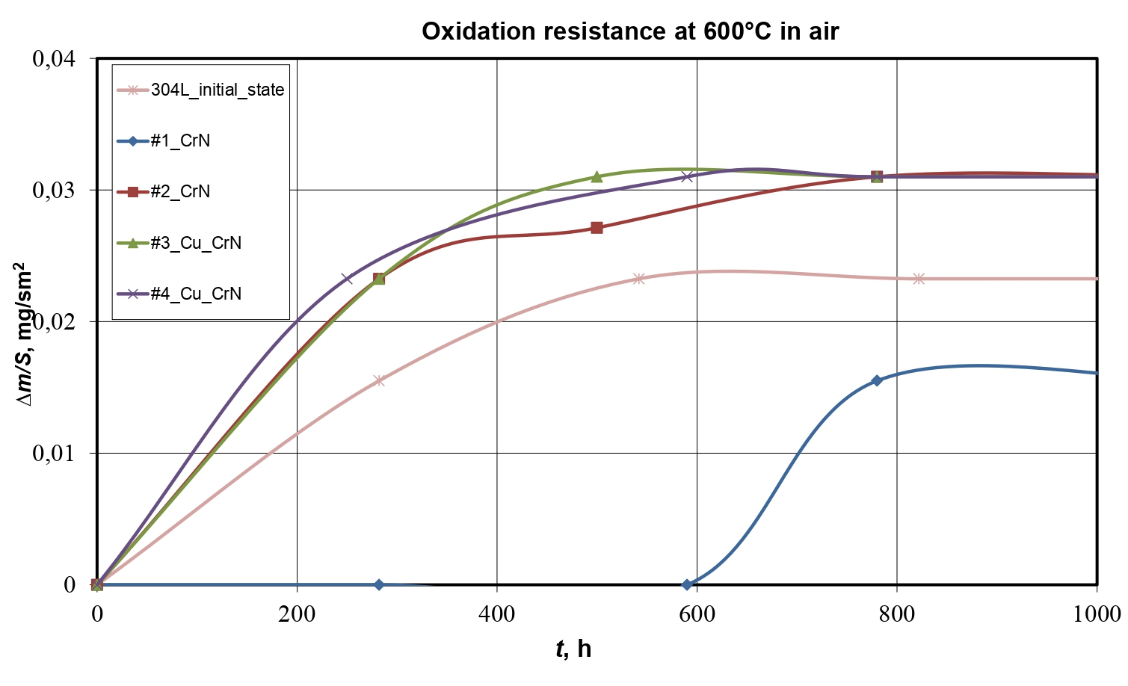
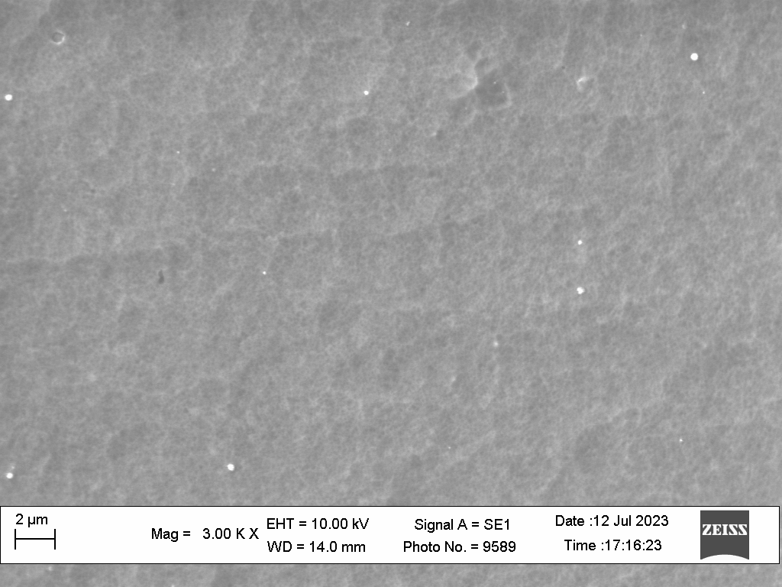
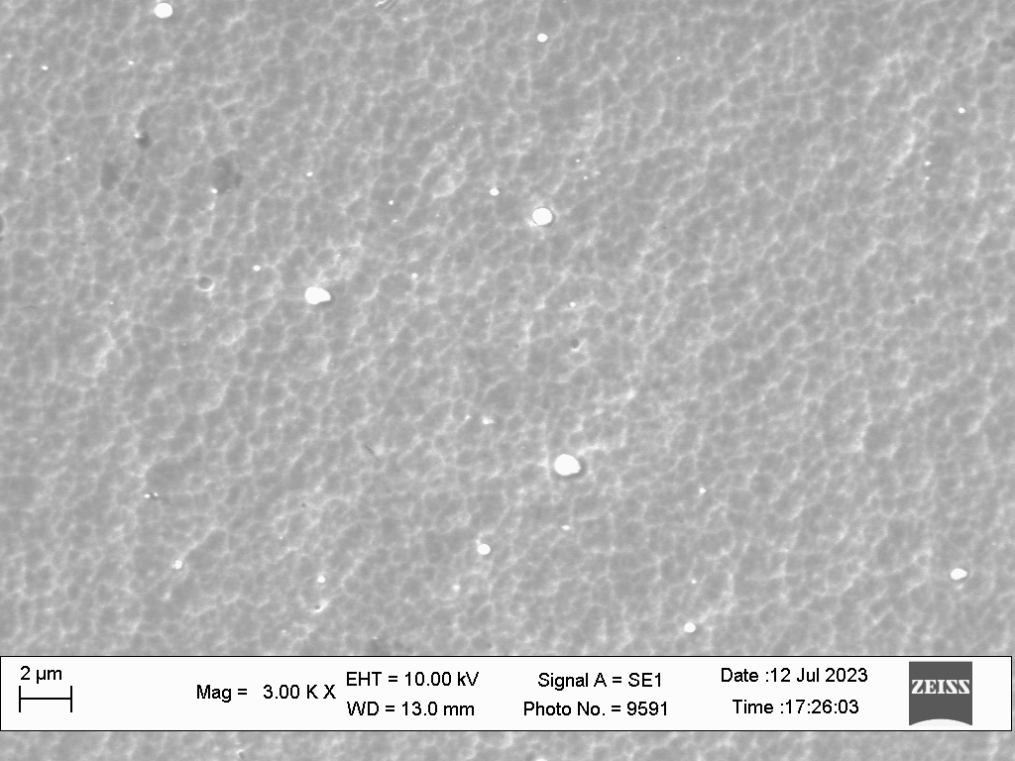
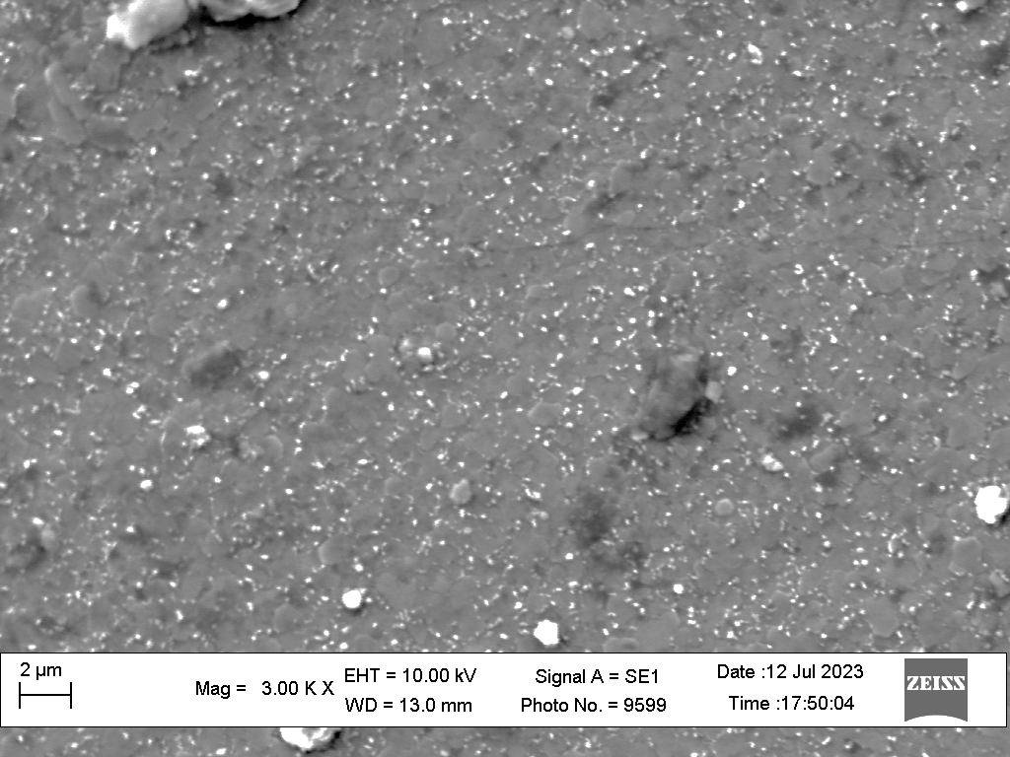


A study of long-term oxidation resistance and its mechanism in films based on CrN deposited on 16-18%Cr steel
Viktoriya Podhurska¹, Yaroslaw Milewski² , Oleksander Kuprin³ and Pavel Shuhayeu²
¹ Karpenko Physico-Mechanical Institute of NASU, Lviv, Ukraine
² Warsaw University of Technology, Warsaw, Poland
³ National Science Center “Kharkiv Institute of Physics and Technology” of NASU, Kharkiv, Ukraine
24th Conference on Material Science, YUCOMAT 2023
Herceg Novi, Montenegro, September 4-8, 2023
Karpenko Physico-mechanical Institute of NASU, Lviv, Ukraine
National Science Center “Kharkiv Institute of Physics and Technology”, Ukraine
Warsaw University of Technology, Poland
INTRODUCTION
Bipolar plates and current collectors are critical metallic components for commercial MCFC stacks. In fact for commercial MCFC systems, up to 55 % of the material content could be the metallic hardware (for the complete system). The stability in a corrosive carbonate atmosphere at high temperature, good electrical conductivity and low contact resistance with the electrodes are desired characteristics of bipolar plates and current collectors. The bipolar plates are exposed to different atmospheres on the anodic side, cathodic side, and wet seal area of MCFC, and hence the ideal material for bipolar plate current collectors should have acceptable corrosion resistance for all of these atmospheres. Stainless steels like 310 S (24–26 wt. % Cr) and 304 L (16–18 wt. % Cr) have emerged as materials of choice for MCFC hardware. However, the hot corrosion in the presence of the carbonate melt is a critical issue with these materials for long-term operation (Fig.1).
EXPERIMENTAL DETAILS
Cathodic arc evaporation – Bulat 3,
Substrate – stainless steel 304L,
Substrate heating - up to 300 ˚C.
One of the most commonly deposition technique used is cathodic arc evaporation due to excellent characteristics of the coatings. The coatings are characterized by high hardness, good adhesion to the substrate, high density, homogeneity.
a
b
One of the methods of protecting and improving the corrosion properties of steel is the application of coatings based on nitrides. The corrosion resistance of Cr-N coatings is better than that of stainless steel and other nitride coatings in the high temperature pressurized water and the oxidation rate in air at 600/800°С is low.
Fig.1 Current collector in the initial state (a) and after long-term operation (b).
RESULTS
Table 1. Results of X-ray structural analysis of coatings of the Cr-N system
Oxidation resistance at 600°C in air
# specimen | Nitrogen pressure P, Pа | Bias voltage U, V | Thickness CrN, μm | Phases | Structural type | Lattice parameter а, nm | L, nm
1 | 2 | 150 | 16,6 | CrN | NaCl (B1) | 0,4173 | 38
2 | 0,2 | 120 | 6,9 | CrN | NaCl (B1) | 0,4166 | 19
 |  |  |  | Cr | BCC (A2)
3 | 2 | 150 | 4,1 | CrN | NaCl (B1) | 0,4180 | 21
 |  |  |  | Cu - sublayer | HCC (А1)
4 | 0,2 | 120 | 2,2 | CrN | NaCl (B1) | 0,4177 | 12
 |  |  |  | Cr | BCC (A2)
 |  |  |  | Cu - sublayer | HCC (A1)
Δm/S, mg/sm²
#1
#2
#3
#4
t, hours
CONCLUSIONS
The analysis of the obtained results showed that the coating based on chromium nitride #1 has the best oxidation resistance and good adhesion, which allows it to be offered as a promising coating for current collectors of high-temperature fuel cells.
#1
#2
#3
#4
Surface morphology of CrN coatings deposited on the stainless steel samples at different nitrogen pressure and bias voltage: upper row – initial state; bottom row – after long-term oxidation at 600°C in the air
ACKNOWLEDGEMENT
This study was supported by „Scheme: Support for Ukrainian researchers under Bilateral Fund of ‘Applied Research’ Programmer” under the Norwegian Financial Mechanism 2014-2021 [akronim: MOLCAR_UA].

